Slide 1
Job Search & Interview
Avijit Mallik
Assistant Professor,
IBA, University of Dhaka

Slide 2
Please re-watch this video at home for the tips for better presentation
https://www.youtube.com/watch?v=iJq-thyDF9Q

Slide 3
You may follow this structure for Your Report
Prefatory Parts
Introduction
Brief overview of the software industry in Bangladesh
Contribution of IT/Software industry in the economy of Bangladesh
Major Companies in this sectors
Government policy and incentives to develop this sector
Job opportunities in this sector
Problems & prospects of this industry
Findings & Conclusion
Appendix

Slide 4
Guidelines for Monday’s group Presentation
Each member must present
Total time for the each group’s presentation is 12 minutes
You MUST have professional attire. Points will be deducted for unprofessional attire.
You must email me the power point presentation before the presentation starts
The marking will be for the entire group

Slide 5
Step 1: Find the Right Jobs
• Build Network:
Its important to have a strong network who can help you finding a job. One should broaden his circle of friends who can help him/her in future for a career move.
A good relationship with university professors can be helpful as they can vouch for you for companies.
Meeting key business people is also crucial in getting a job.
These people can be met through LinkedIn, business events or through family and friends. These people can help one navigate the process of getting his/her desired jobs.

Slide 6
Step 1: Find the Right Jobs (Cont’d)
• Identify Appropriate Jobs:
Identifying the right job requires one to analyze internal factors such as his/her values, short-term & long-term goals, skillsets, his/her wants, needs & desires as well as external factors such as salary, annual benefits, vacation time, provident fund, health insurance, perks, office environment, nature of work etc.
Another important factor is work experience which will filter the jobs that’ll match the candidate. The candidate needs to honestly assess these factors and then search the jobs that’ll suit him/her best.
Whatever you decide to become in life, “START EARLY”.

Slide 7
Step 1: Find the Right Jobs (Cont’d)
Find the Employer:
For a fresh grad, career center can provide a good medium to connect with potential employers. The career center maintains databases on registrants with educational records, resumes, and recommendations for potential employers to check. The centers provide outstanding job search assistance. Most provide directories with contact names and addresses for the big corporations. And the majority provide chances for interviews.
One can also utilize his/her personal connections to find opportunities. He/she can also look into classified ads, online sources like LinkedIn Jobs, Glass Door, Indeed etc. Finally, there are employment agencies and headhunters who manages hiring for top companies. A candidate can contact these agencies and expect to get into the hiring process for a job that matches his/her profile.

Slide 8
Step 2: Preparing the application documents
The applicant documents play crucial part in getting a job.
These documents include mainly a resume, a cover letter, your grade/ marks sheet, HSC, SSC & graduation certificates, NID, copies of other relevant certificates etc.
But the main two documents that needs your attention are resume and cover letter. These documents need selling, thus creating them is similar to creating a sales document. Your capacity to perform work is the product or service you are offering.
The reference and resume resemble the supporting documentation that goes with the sales pitch. The sales message and the cover message are quite similar.
List every detail about yourself that you think a potential employer would want to know before anything else. Learning as much as you can about the business, its strategies, rules, and operations is part of studying the task.

Slide 9
Step 2: Preparing the application documents (Cont’d)
The firm's website, annual report, and other publications, as well as several corporate databases, may all be studied. You can also look up any recent news items about the company there.
Proper construction of resume and cover letter is essential to get to the interview stage of any job. As there are many other candidates like you who is competing for the job, your resume and cover letter needs to stand out to get the attention of the person in charge of hiring. To do that you need to correctly structure the CV and write a persuasive cover letter.
You also need to put an extra effort in tailoring these documents to the overall theme of the company. For example: banks want CVs that are very professional, brief and key points highlighted. Therefore, you should focus greatly on making your CV as streamlined as possible while emphasizing your strengths and accomplishments that align with the needs of the business.

Slide 10
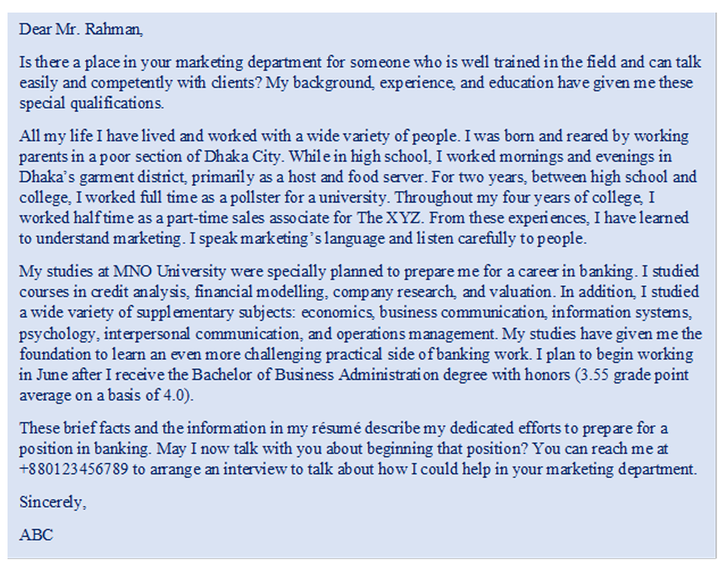
Sample Cover Letter

Slide 11
Step 3: Preparing for interview factors to keep in mind
Gather Information about the Company: Before going to the interview, you need to learn about the company. Learn about the company's management, people, business procedures, present activities, and goods or services it offers. Such information will enable you to converse intelligently with the interviewer. And maybe more importantly, the fact that you took the effort to research the organization will probably make the interviewer impressed. You could even get a competitive edge from that effort.
Wear Appropriate Attire: The way a candidate looks speaks volumes about their personality, professionalism, and ability to discern the unspoken laws of a given scenario. Therefore, clothing and grooming are crucial components of preparation. Your study into various professions and sectors should give you an understanding of what is expected of business dress. A conservative business suit in a dark solid color or a mild pattern, such as pinstripes, is appropriate for many professional or management professions. Men should wear an unobtrusive tie, and women should wear a shirt that matches their outfit. Traditional wear like saree, salwar-kameez can be worn if they are not too colorful or ornamental..
Work on your looks: Boys, Look presentable. Look neat. Shave well. If you have a beard, trim well. Trim your hair. Though maintaining personal hygiene should not be an occasional thing, it’s mandatory to look professional in an interview. That's the bare minimum. And don't confuse it with facial features. Anyone and everyone can look presentable with the right approaches. Your look alone will not land you on your dream job, however, looking clumsy can definitely stop you from reaching there.

Slide 12
Step 3: Preparing for interview factors to keep in mind (Cont’d)
• Prepare Answers in Anticipation of Questions: Some of the interviewer's questions should be easy for you to predict. Typically, questions concerning your academic history (courses, grades, awards, etc.) are asked. Questions regarding hobbies, aspirations for your career, preferred locations, and involvement in organizations are also relevant. These questions should have answers ready in beforehand. Then, your answers will be thorough and correct, and you'll speak with grace and assurance. Planning will also demonstrate how enthusiastic you are.
• Keep Calm: You should appear calm and composed while being examined by the interviewer. Keep your body and facial motions under control. Self-discipline is needed to develop these controls, therefore work at it. Trying to convince yourself that the tension you feel during an interview is normal may be useful. To create the greatest possible impression to the interviewer, you must learn to regulate your emotions.
• Feel free to say “I don’t know.”: The interview should be approached as a conversation, not as an oral exam. Never go into an interview worried about failing one question. If you don’t know an answer, politely say “I don’t know, Sir.”
• How you enter and exit is important: Smile at everyone when you come in and leave time for a casual or humorous comment or two at the beginning. Let them set the pace. Thank them and make a polite exit when they indicate the interview is over, but don’t rush out the door

Slide 13
Step 4: Follow up and Finish the Application
You might need to send a quick thank-you note through letter, email, or phone after the interview. It is acceptable to contact the potential employer by phone, email, or letter to find out the status of your application if you haven't heard back from them after a fair amount of time has passed. If the offer from another firm has a time constraint, you should definitely take advantage of it.

Slide 14
Typical Interview Questions:
What can you do for us?
Would you be willing to relocate? To travel?
Do you prefer to work with people or alone?
How well has your performance in the classroom prepared you for this job?
What do you expect to be doing in 10 years? In 20 years?

Slide 15
Typical Interview Questions: (Cont’d)
Why should I rank you above the others I am interviewing?
Why did you choose (Web Development/Machine Learning) for your career?
How do you feel about working overtime? Nights? Weekends?
Is your college record a good measure of how you will perform on the job?

Slide 16
Typical Interview Questions: (Cont’d)
What have you done that shows leadership potential? Teamwork potential?
What is your greatest weakness?
Why Did you choose our company ?
What are your beginning salary expectations? & Many More…
Do you have any question to ask us?

Slide 17
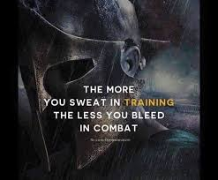
ALWAYS REMEMBER

Slide 18
THANK YOU FOR YOUR PATIENCE.
ANY QUESTION??

